Slide 1
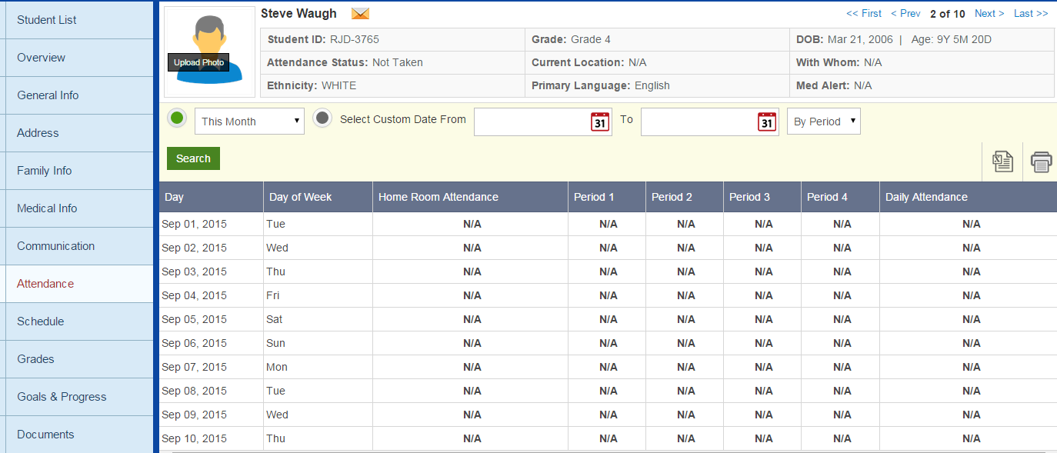
Need attendance data
No horizontal scrolling…take it off the bottom of the screen

Slide 2
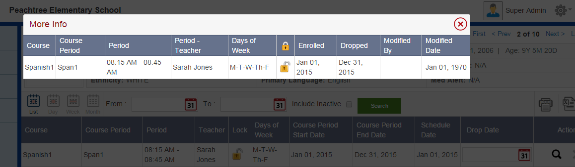
Course End Date
Wrong date

Slide 3
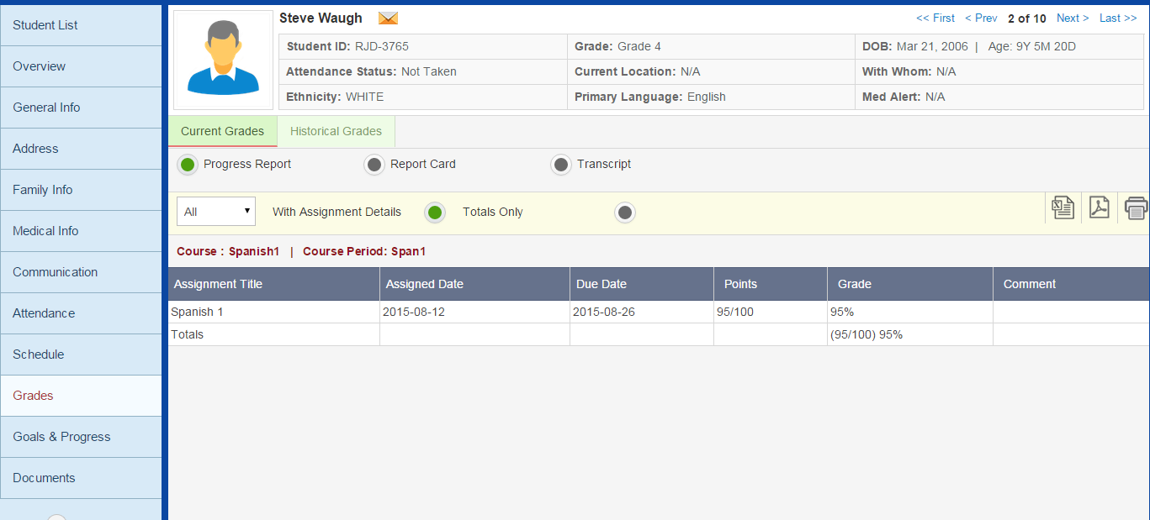
Radio button should be before text
This should be a Letter Grade from Grade Scale

Slide 4
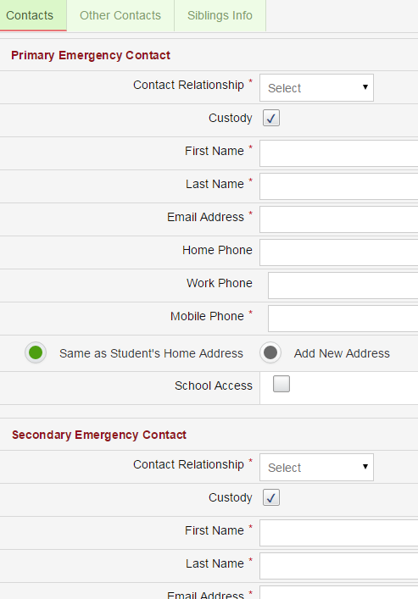
All fields should be left aligned

Slide 5
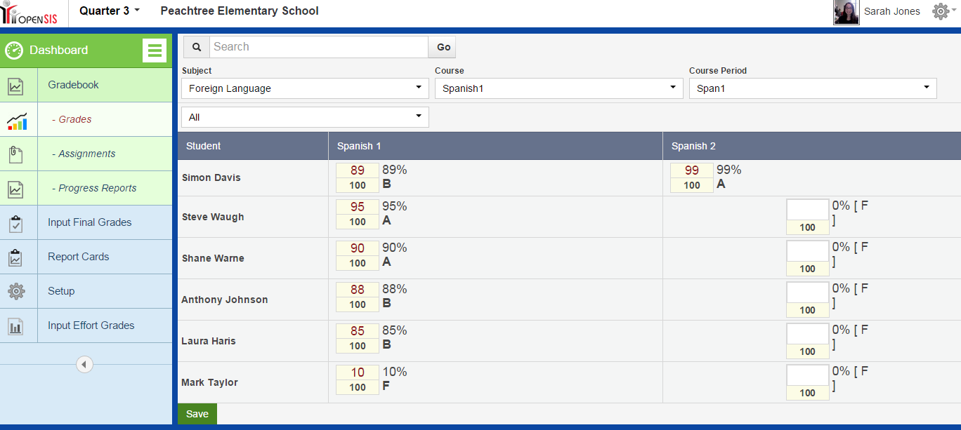
Teacher Portal
Show Student ID in a column next to name
These need to be left aligned

Slide 6
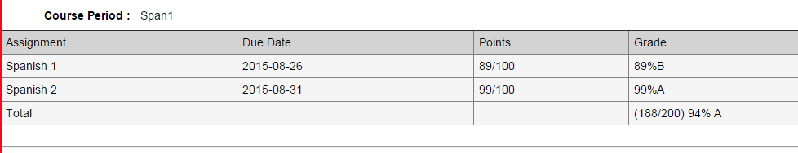
space
Progress Report
B (89%)
A (188/200) 94%
space

Slide 7
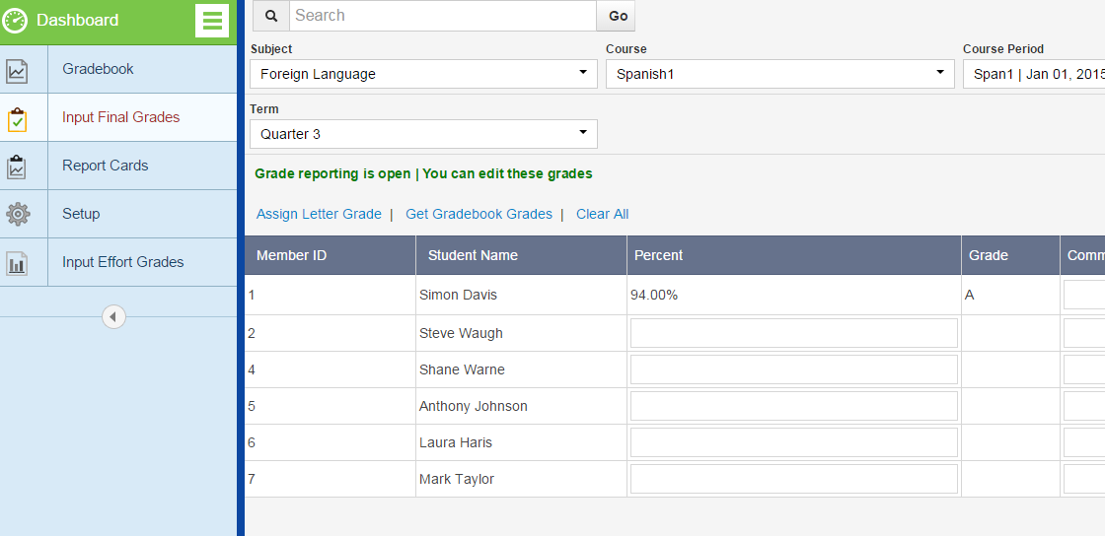
Add Column Student ID

Slide 8
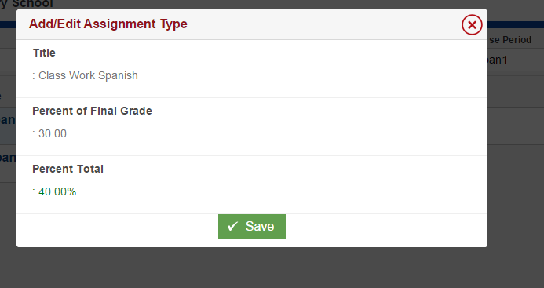
No colons

Slide 9
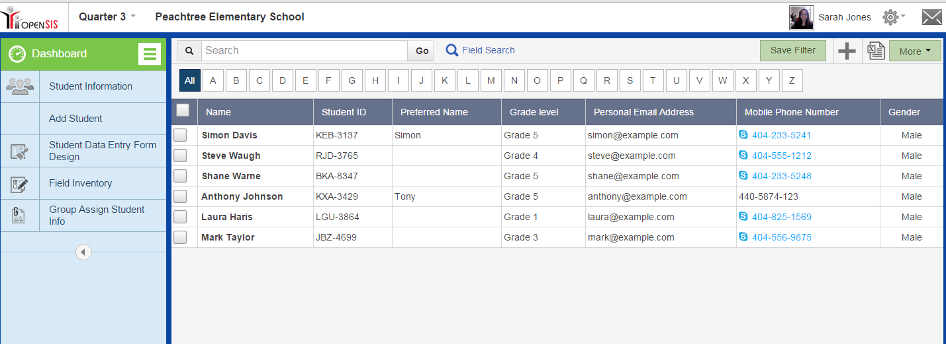
What non-sense is this???????

Slide 10
